Slide 1

WE CONNECT
“Student Handler Application. A Rest web server”

Slide 2

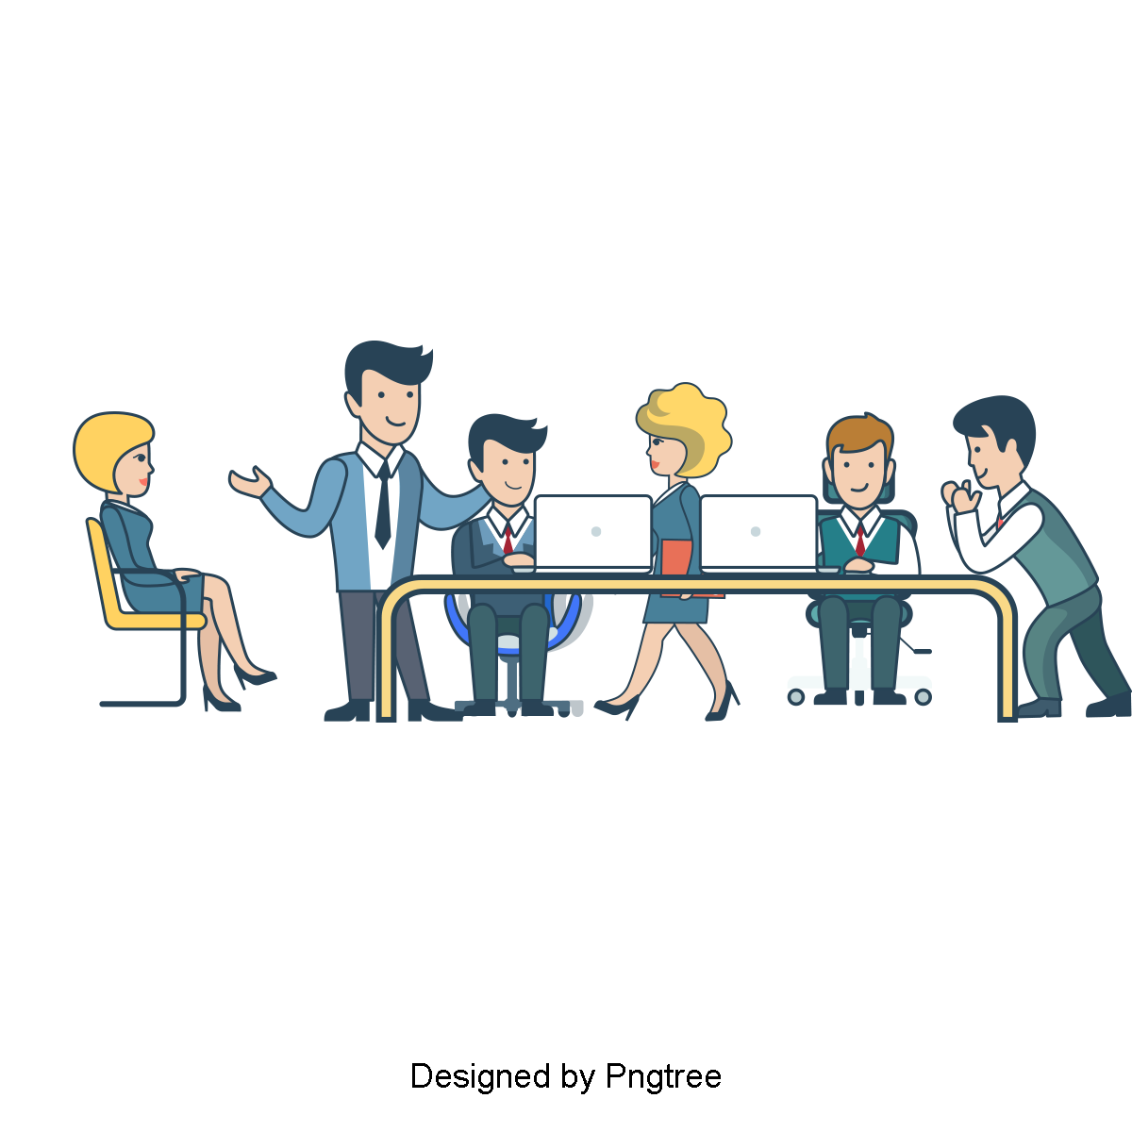
Under the guidance of Mrs .Zareena begum

Slide 3
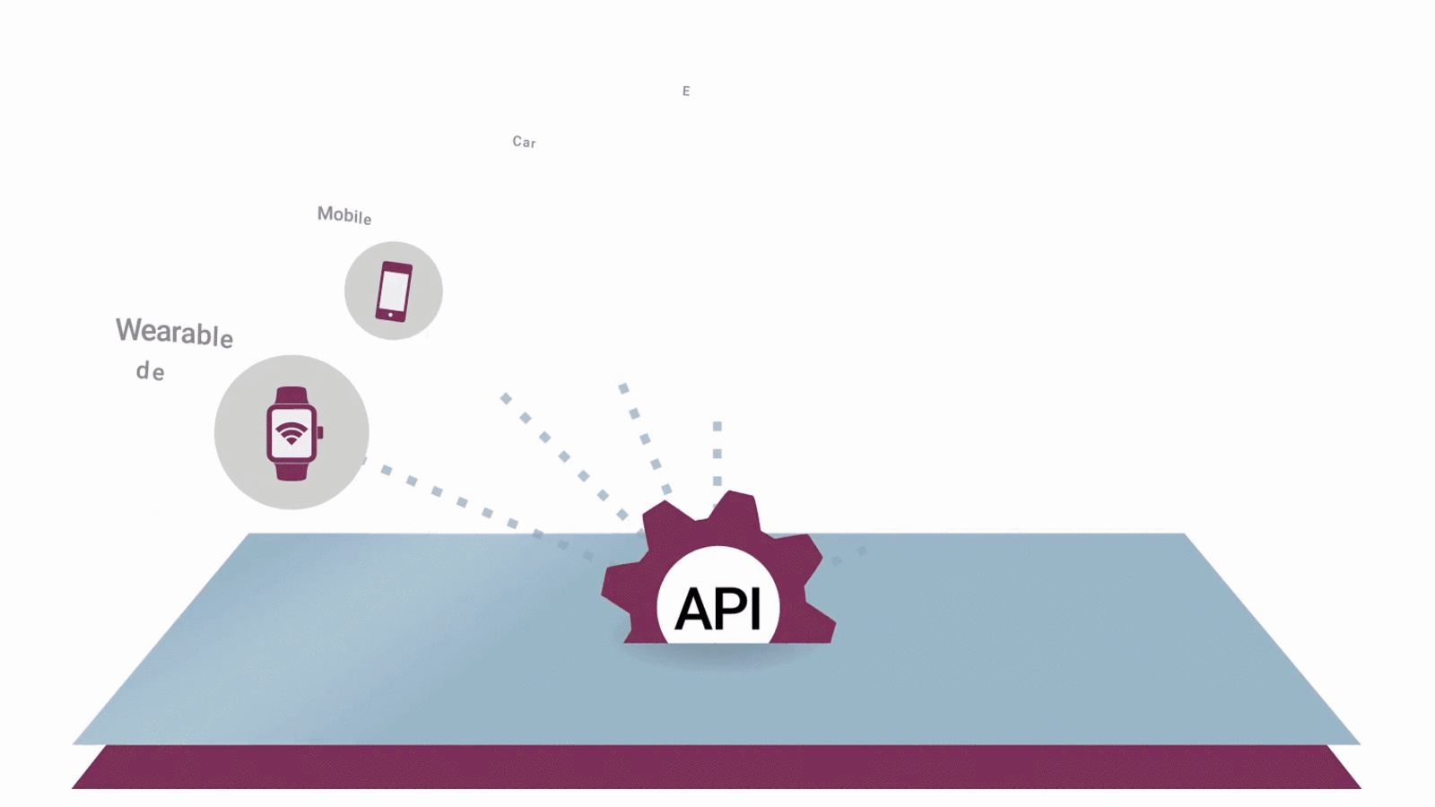
Dashboard
01
Abstract
02
Team
03
Introduction
04
System requirement and specification
05
Model.
06
Present vs proposed system
07
Technology overview.
08
conclusion

Slide 4
We Connect
we-connect is an web server it’s a purely a web service based on MVT(model view controller) as microservices architecture.
Which as feature login with o-auth ,alerts ,pdf(BLOB).
Client can access the data using GET,POST,PUT,DELETE methods such as HTTPS REST(Representation state transfer) protocol’s.
Client can extends the application using any language which can support the Rest protocol’s
Jersey-JAX is the oldest version of Spring boot which is a web-Server model as WAR which can runs in a server such as Apache tomcat or jetty or NGNIX Cluster.
It can best fit model in a cloud containerization as DATA Pipe line or ETL.

Slide 5



LOGIC , REPRESENTATION , BUILD , TEST
DATABASE
API
CLIENT

Slide 6




Team of project
01
02
03
04
srinivas
Nikhil
Ainavolu Abhinav
Shabothu saiteja
19641A05M8
19641A05N1
19641A05J0
19641A05N5

Slide 7
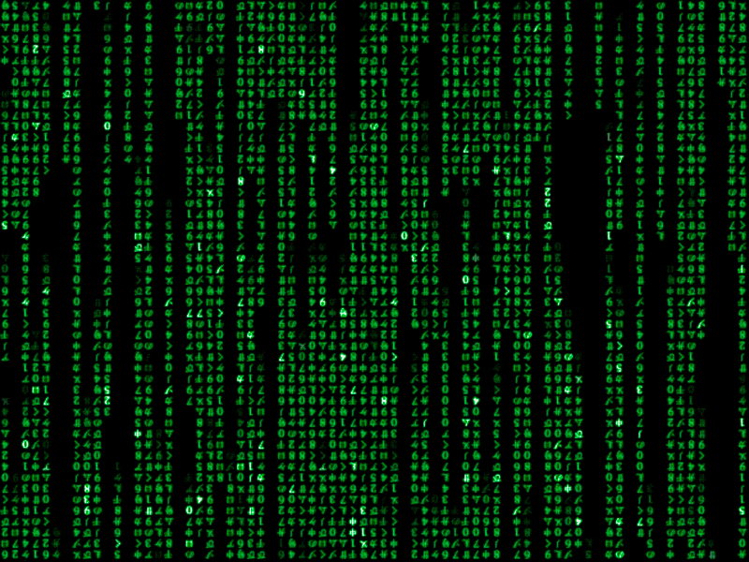

Slide 8
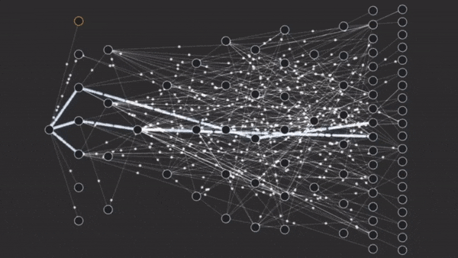
Internet and microservices
Internet and WWW worldwide system of computer networks
A web service is either: a service offered by an electronic device to another electronic device, communicating with each other via the Internet, or a server running on a computer device, listening for requests at a particular port over a network, serving web documents
A microservice architecture – a variant of the service-oriented architecture structural style – is an architectural pattern that arranges an application as a collection of loosely-coupled, fine-grained services, communicating through lightweight protocols

Slide 9
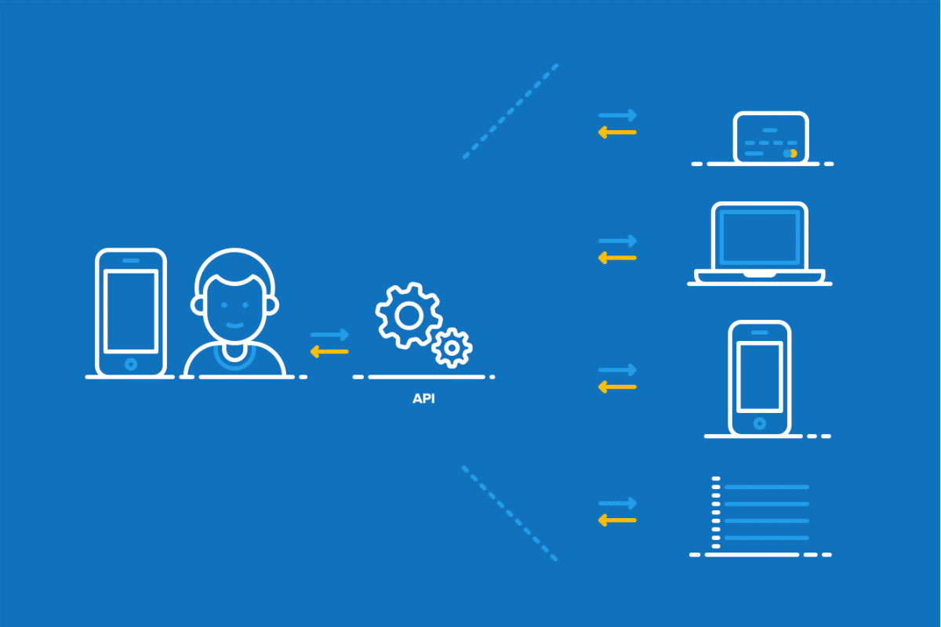

Slide 10
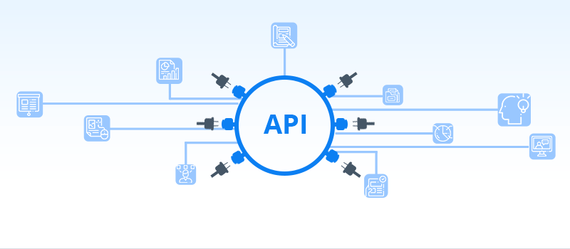
What is API?

Slide 11
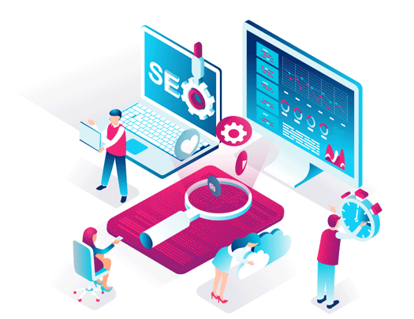

Slide 12
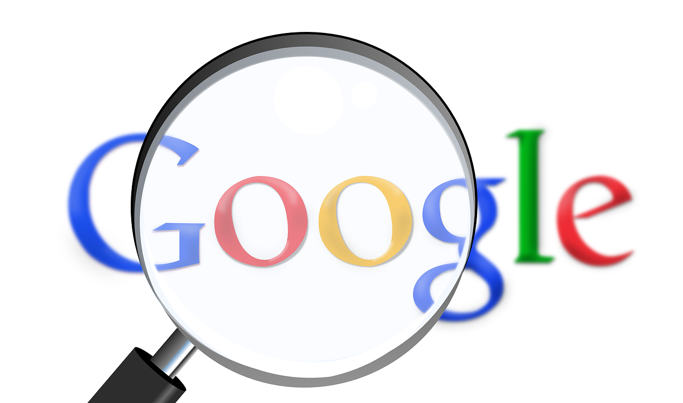
What is API?
An application programming interface (API) is a way for two or more computer programs to communicate with each other
How its works?
The working principle of APIs is commonly expressed through the request-response communication between a client and a server. The client is any front-end application that a user interacts with. The server is in charge of backend logic and database operations. In this scenario, an API works as a middle layer between the client and the server, making it possible to send data requests and responses.
Why is API used?
Because APIs simplify how developers integrate new application components into an existing architecture, they help business and IT teams collaborate. Business needs often change quickly in response to ever shifting digital markets, where new competitors can change a whole industry with a new app.

Slide 13
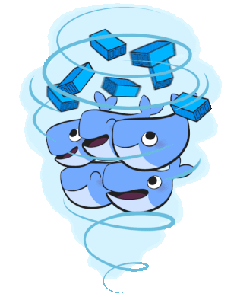
System requirements and System Specification
Software
Java 18
Jersey and Javax dependencies
Maven
Hibernates
Log4J
Postgres and mongo Database
Google account SDK API dependencies
Google cloud auth
Docker and container config
Post-Man API testing tool
Hardware
I3 with 8 core GPU
Linux 20.0.1 / Windows 10.
8 GB RAM with 2100 MZH
100MBPS Bandwidth.

Slide 14
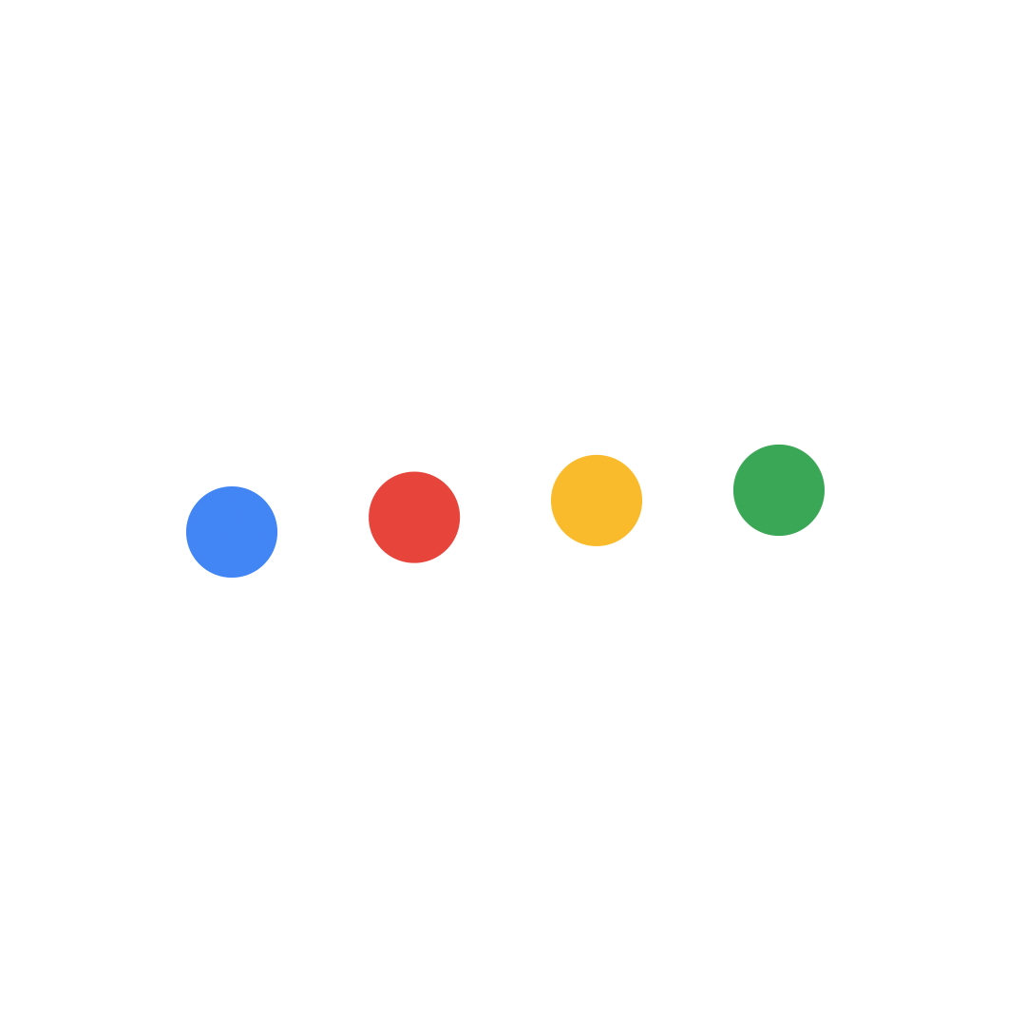
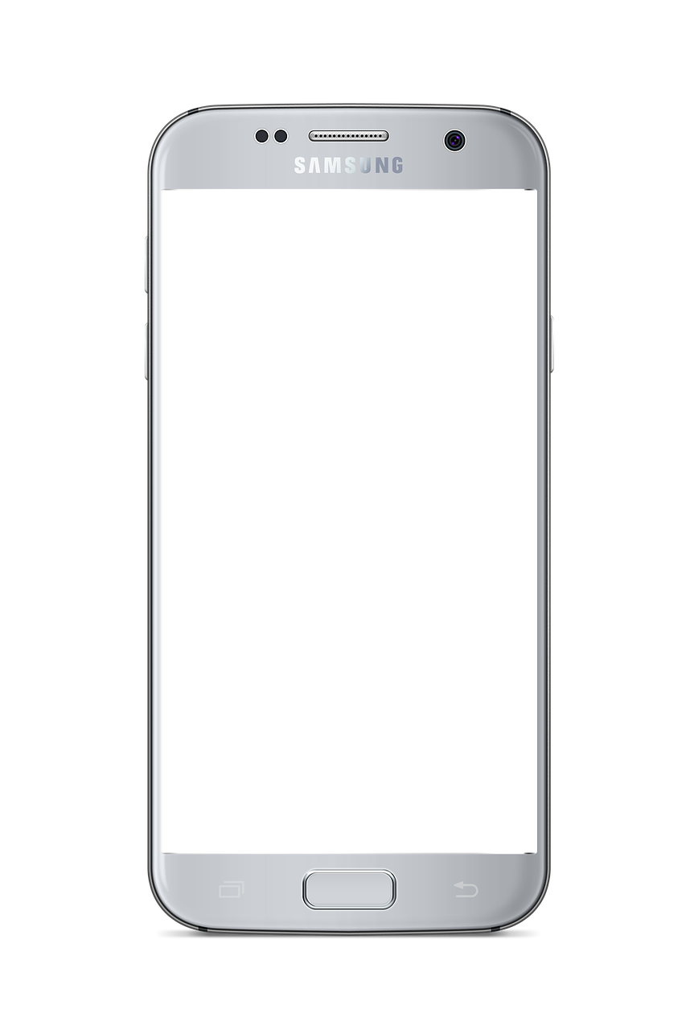
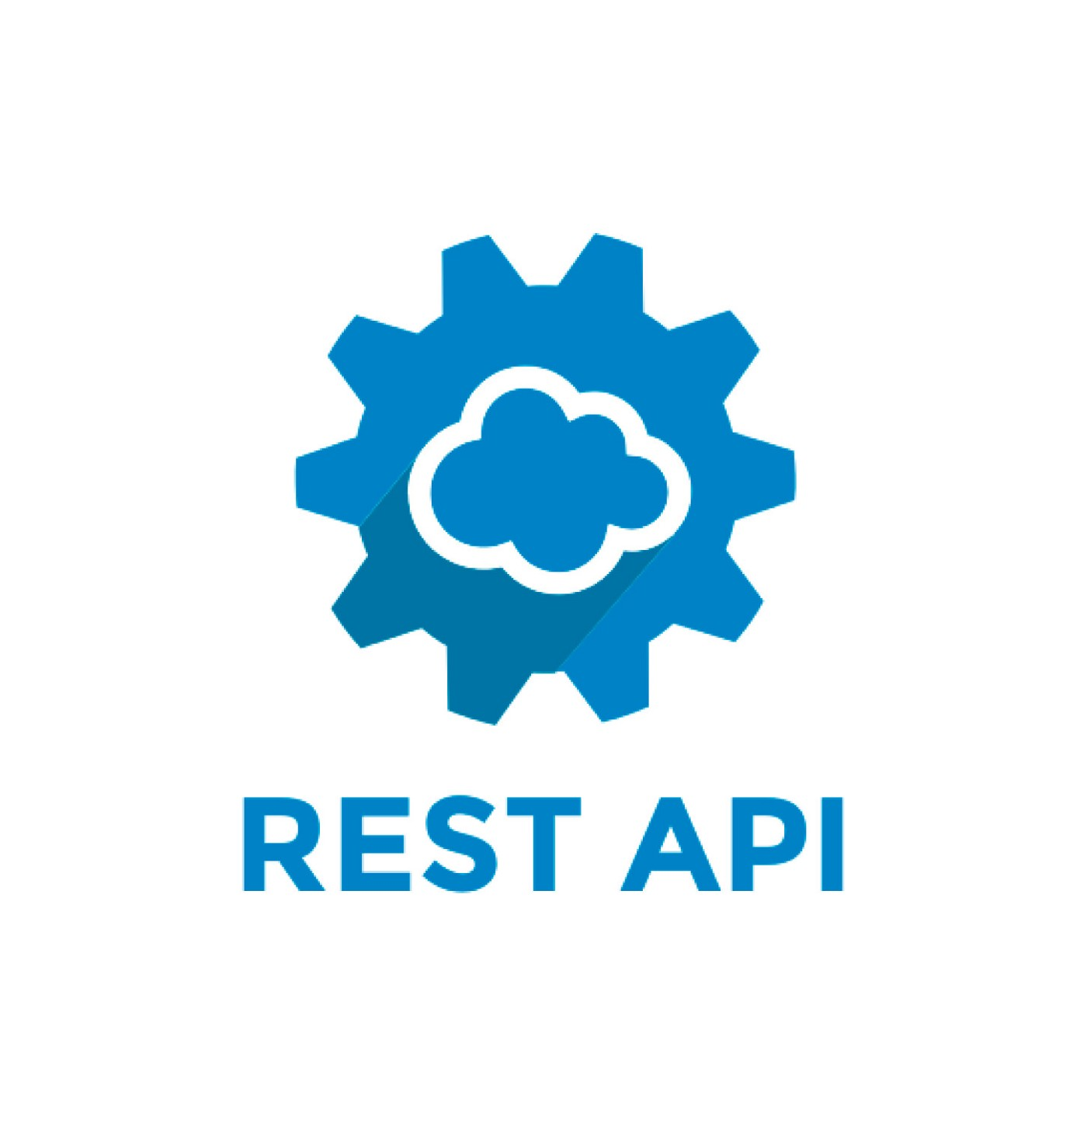
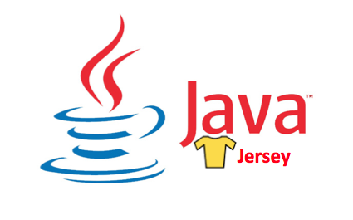
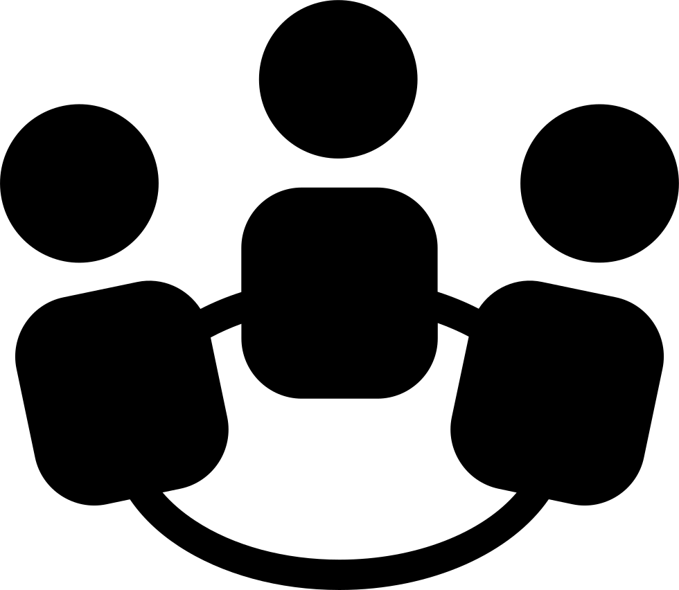


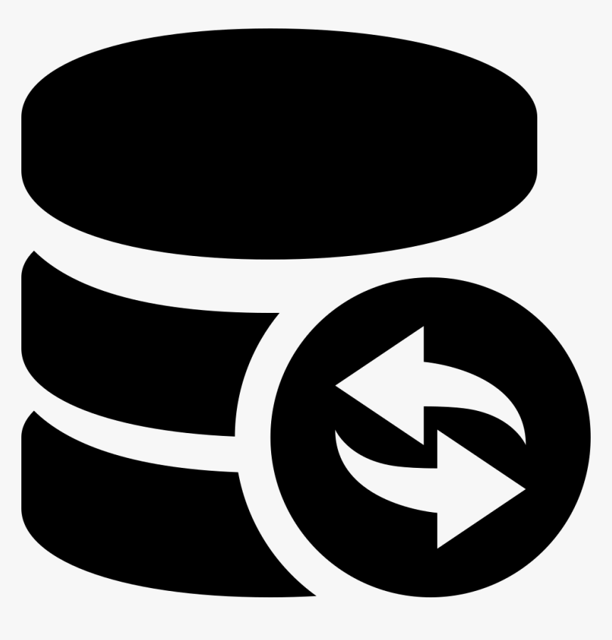
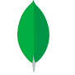
Micro-services Architecture.
Client Application
Https – SSL – JSON.

Slide 15
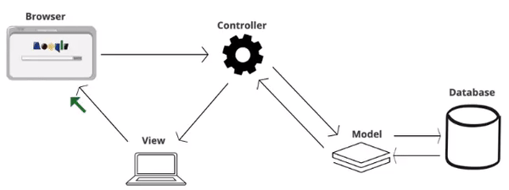
Model view controller

Slide 16
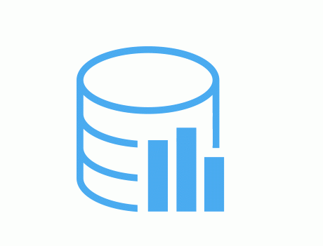
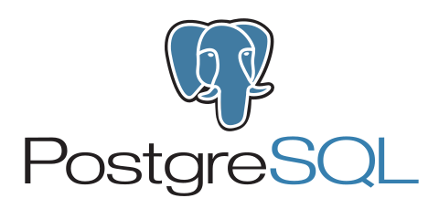
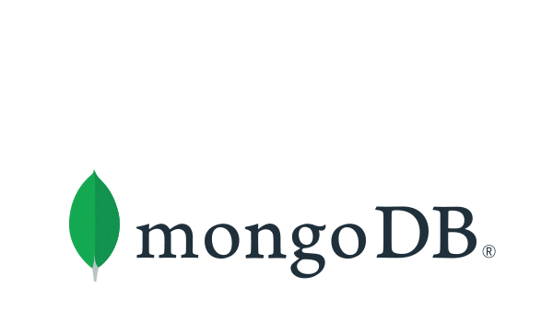
DATABASE MODEL
USER
Userid
Username
Userpass-code
userHashKey
ALERT
alertId
alertTitle
alertData
alertBloB
ACCESS
Access-Id
Access-timestramp
accessUserId
Collection
Id : data
Relational Data
Non-relational

Slide 17
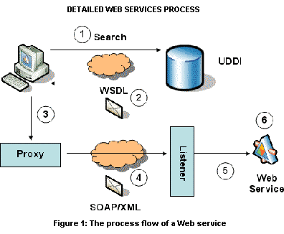
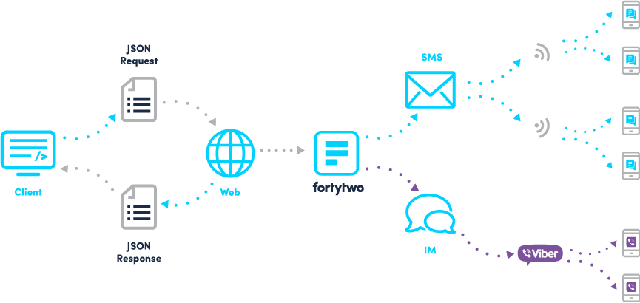
Present System vs proposed System
SOAP(simple object access protocol)
REST(representational state transfer)

Slide 18
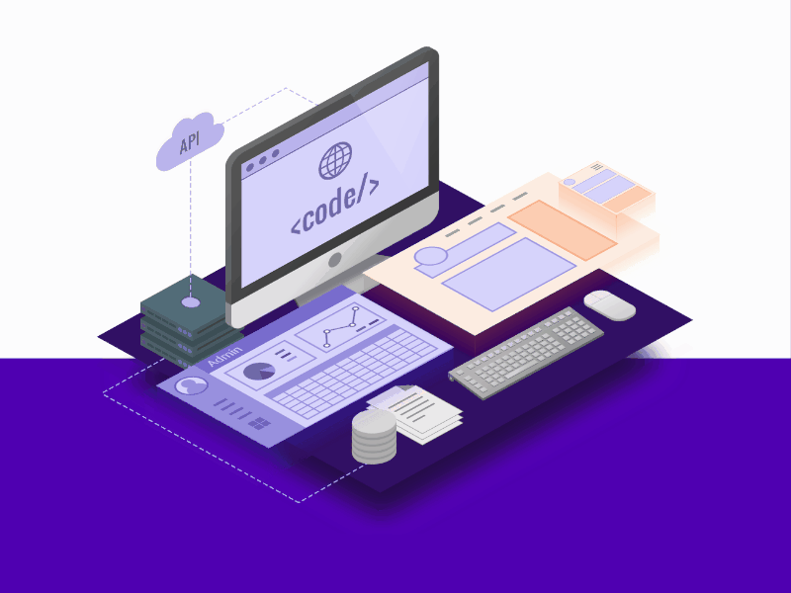
Technology overview

Slide 19

Jersey –Jax and Maven
Jersey contains a REST client library which can be used for testing or to build a real client in Java
Maven is a build automation tool used primarily for Java projects.
Apache Maven is a software project management and comprehension tool. Based on the concept of a project object model (POM), Maven can manage a project's build, reporting and documentation from a central piece of information.
Dependency injection (DI) is the process of supplying a resource that a given piece of code requires. The required resource, which is often a component of the application itself, is called a dependency.

Slide 20
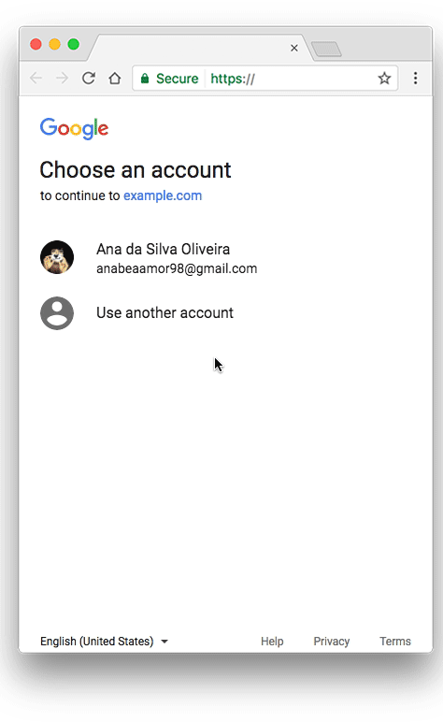
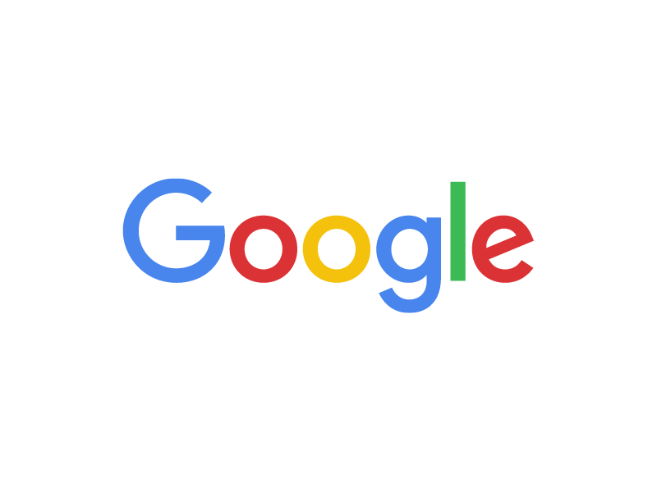
Google SDK and o-auth (cloud)
Google handles the user authentication, session selection, and user consent. The result is an authorization code, which the application can exchange for an access token and a refresh token. The application should store the refresh token for future use and use the access token to access a Google API.

Slide 21
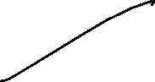

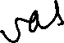
Thank You

